Slide 1


Slide 2
What Was I Thinking?
A First Scratch Built Diorama

Slide 3
Objectives
To build a diorama of at least two buildings that are scratch built from plans.
To use various techniques learned at conventions, shows, and from magazines.
To have something to talk about today!

Slide 4
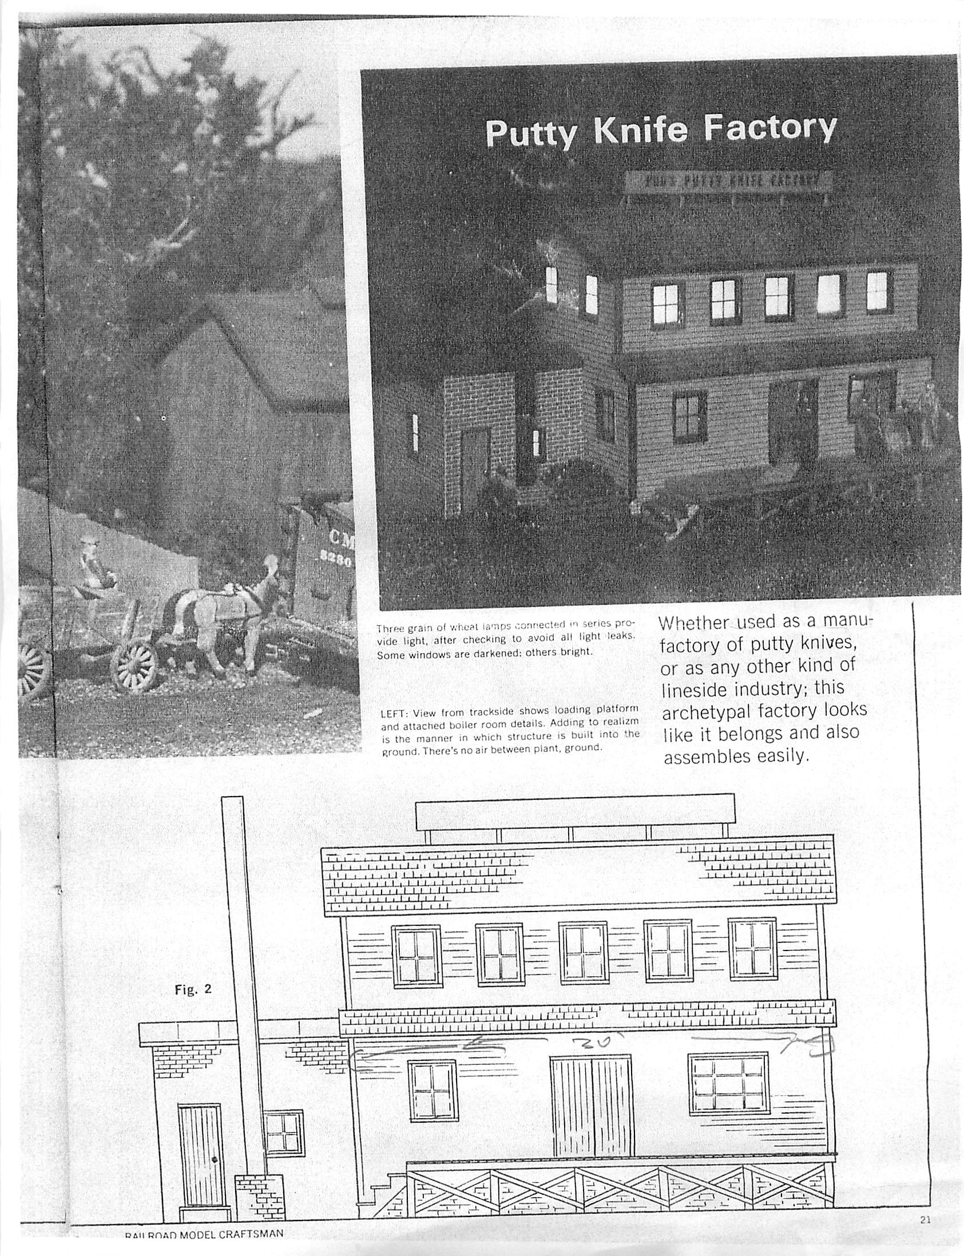
The Original Plan
I started with a plan from a 1969 Model Railroad Craftsman: the classic E.L. Moore design, “Pud’s Putty Factory”

Slide 5
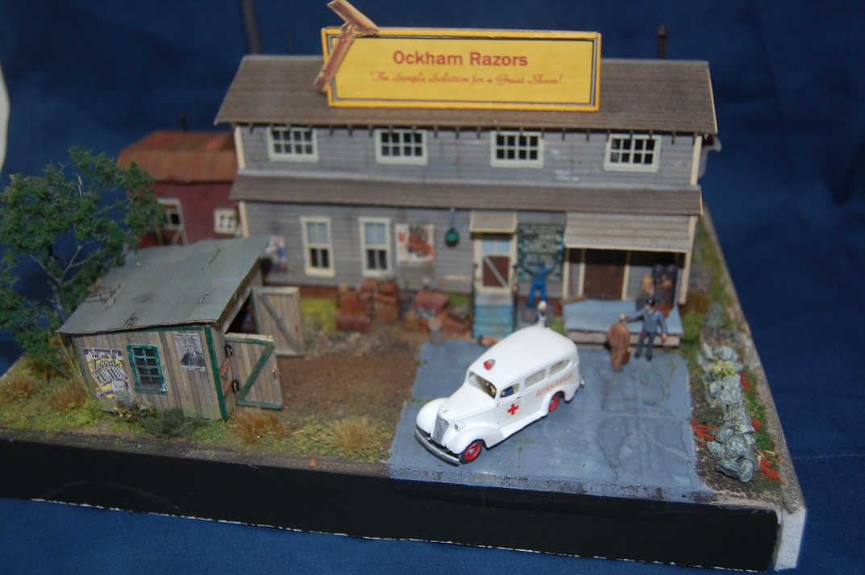
The Finished Product
After revising the plans, updating the materials, and adding a board by board shed, the finished product looked like this:

Slide 6
What Makes a Craftsman Kit?
Laser cut walls
Window and door treatments
Roofing materials
Templates
Plans
Wood, lots of wood
Castings

Slide 7
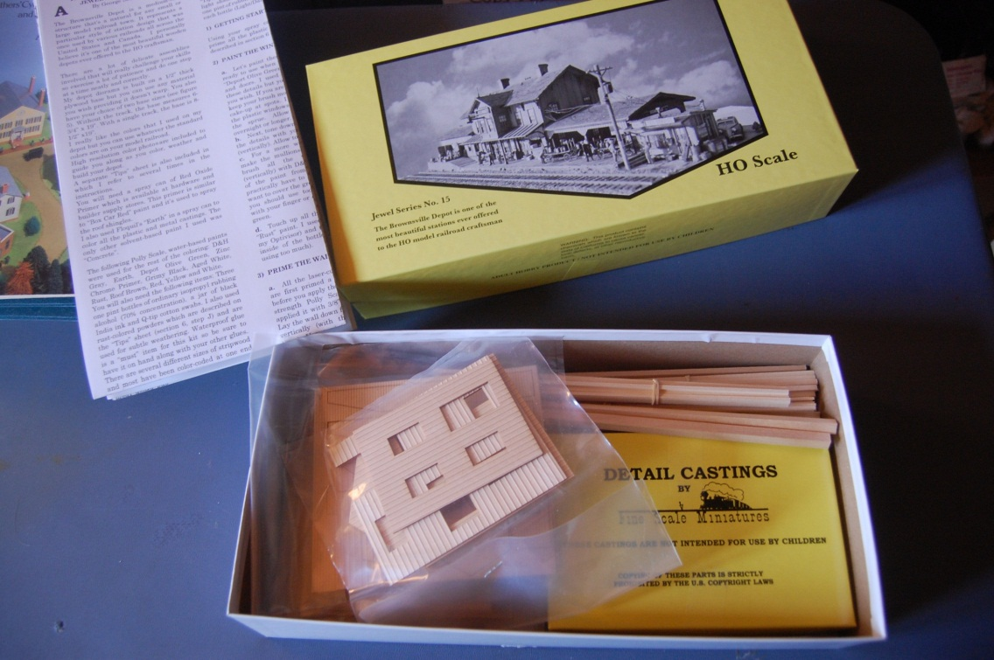
And This is What you Get:

Slide 8
Step One
Find plans for what you want to model

Slide 9
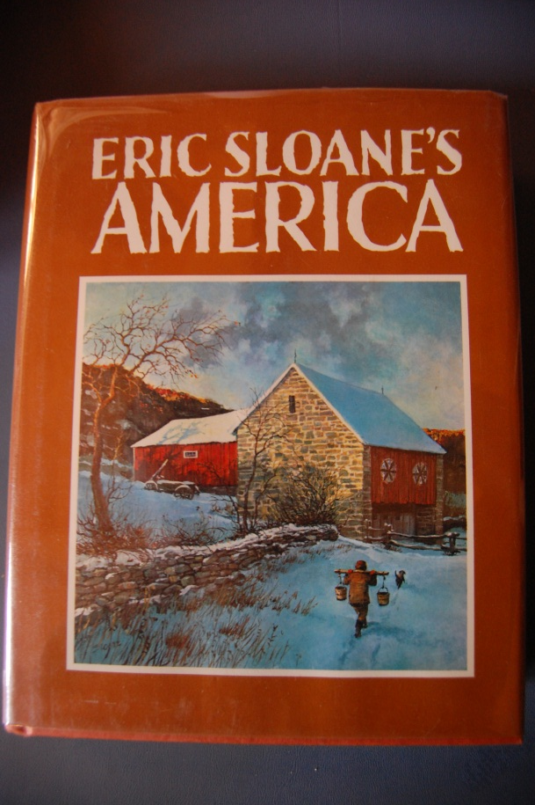
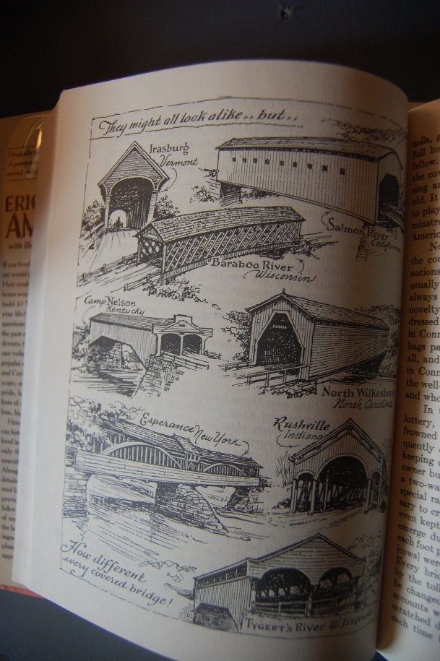
Books

Slide 10
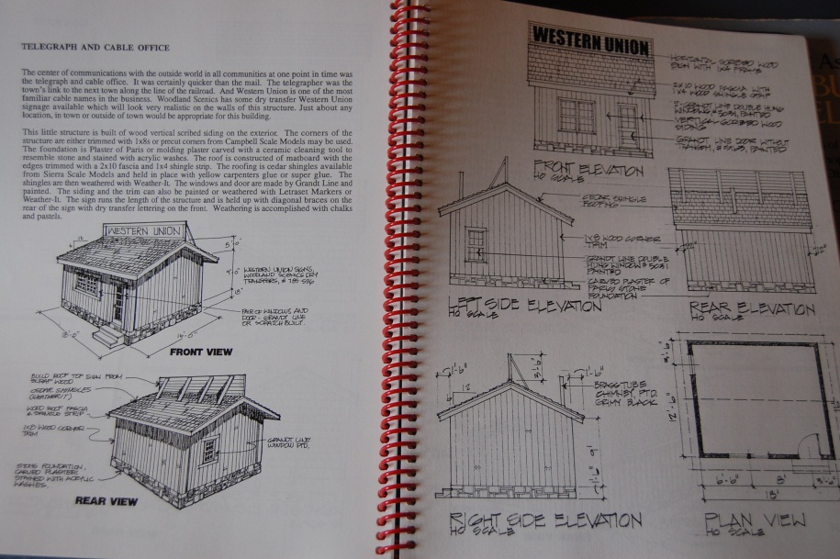
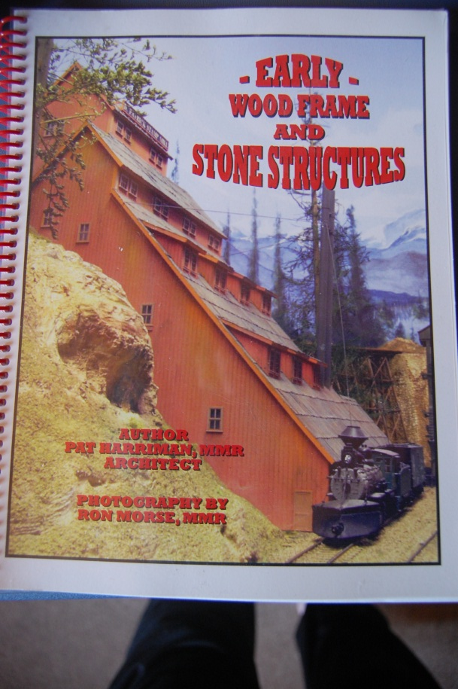

Slide 11
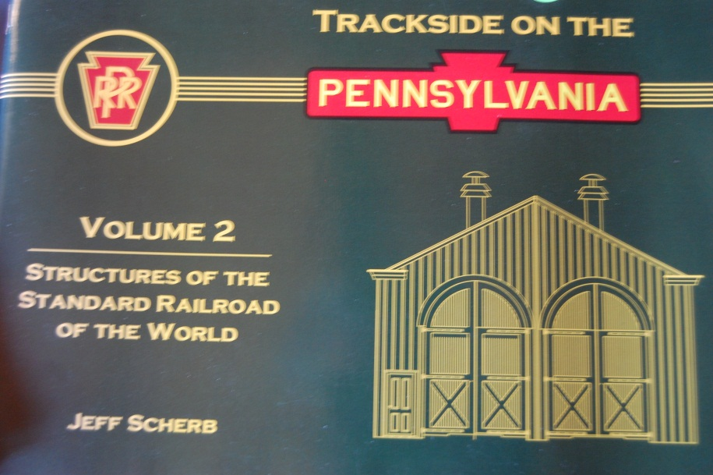
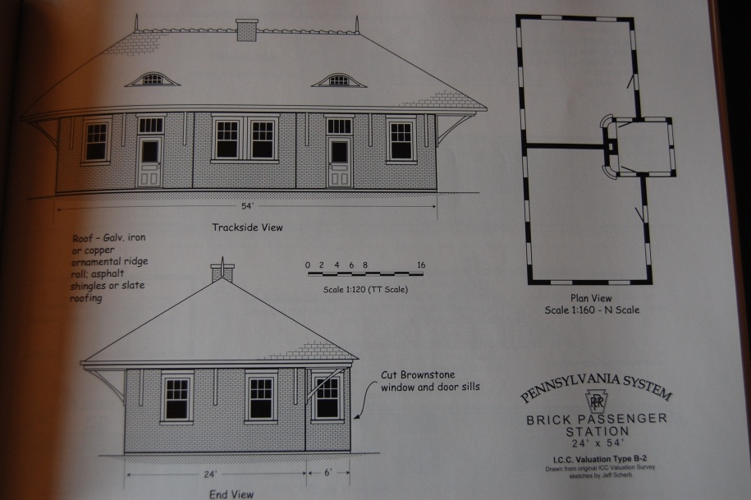

Slide 12
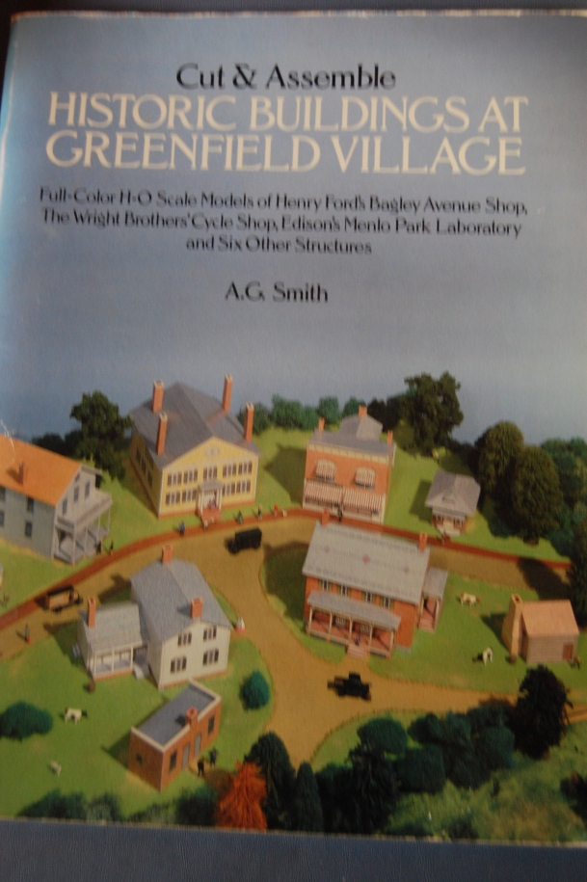
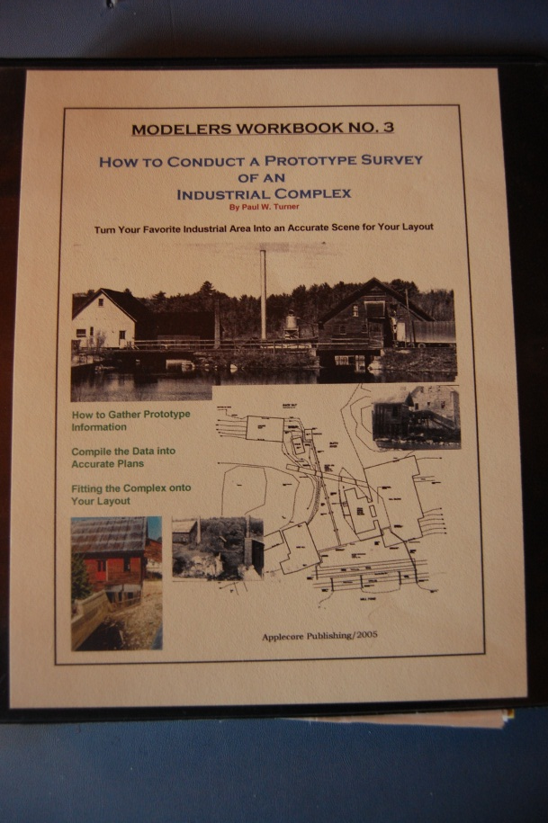

Slide 13
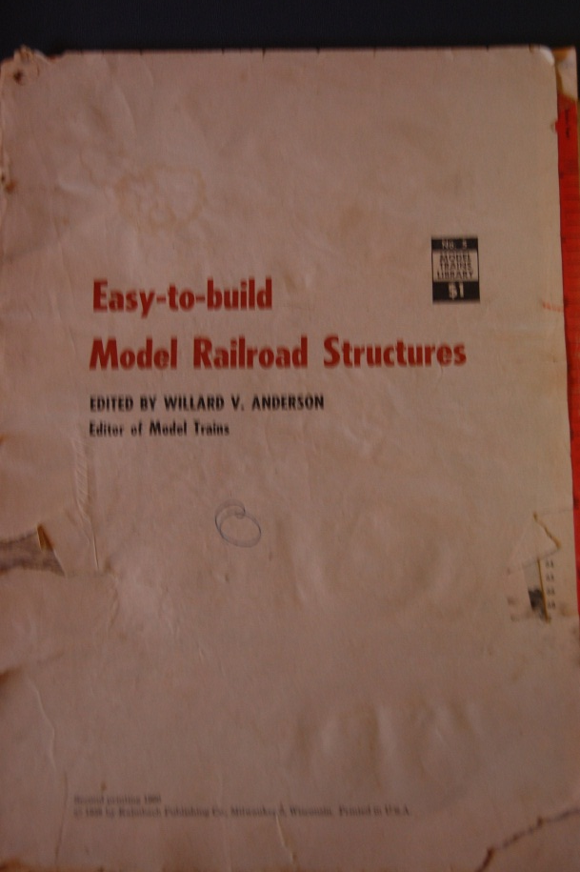
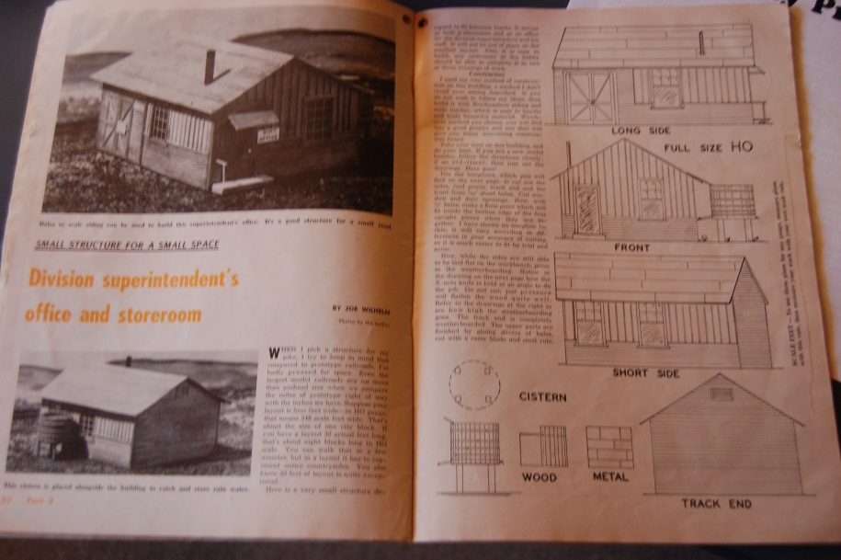

Slide 14
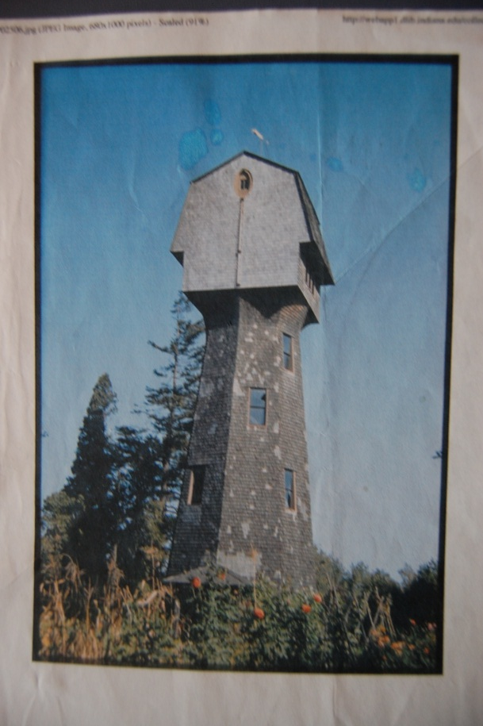
Photographs
This building was in Jamestown, Rhode Island. Probably no one will ever make a kit of it.

Slide 15
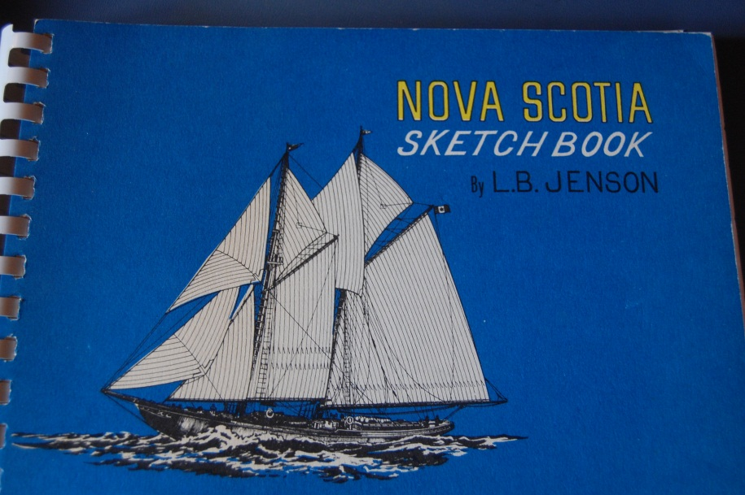
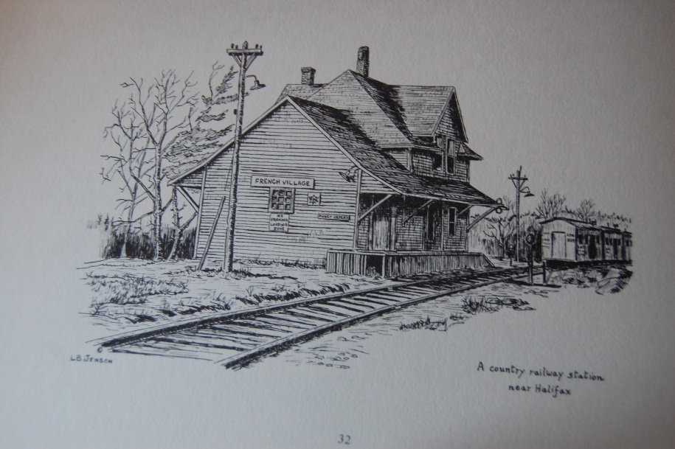
Diagrams and Illustrations

Slide 16
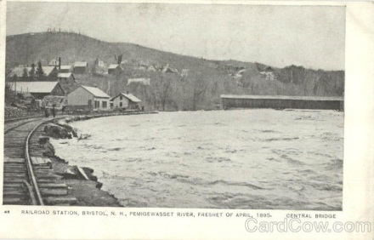
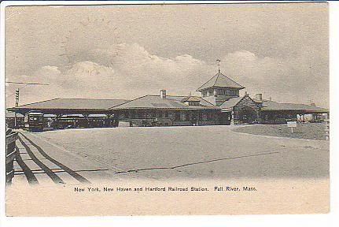
Postcards

Slide 17
Step Two
Adapt or Draw Plans

Slide 18
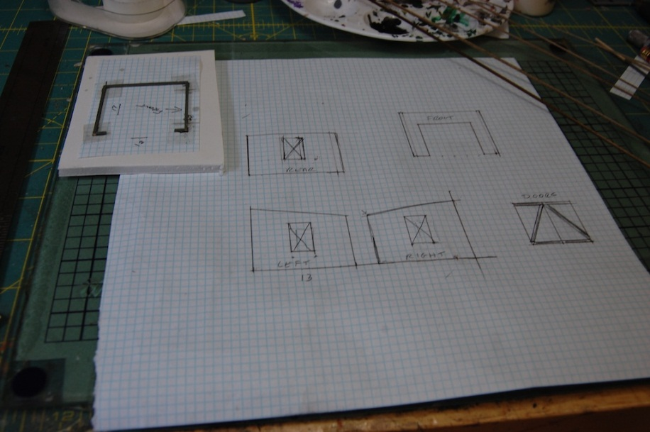
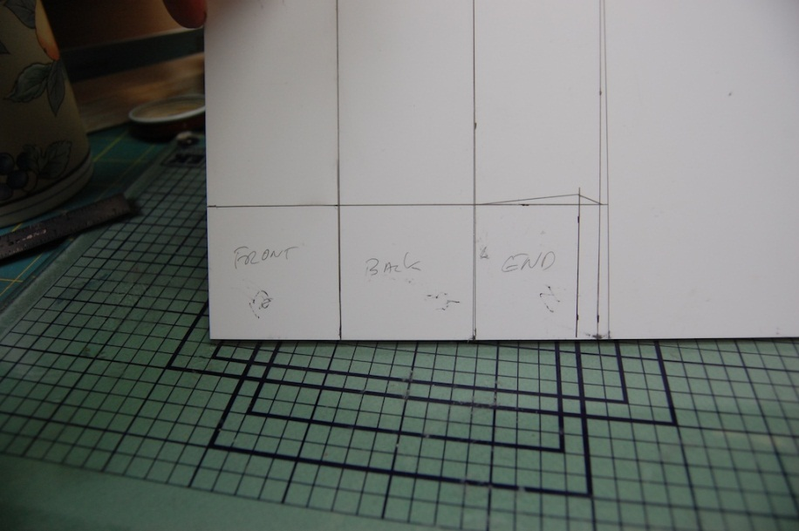
Using Graph Paper

Slide 19
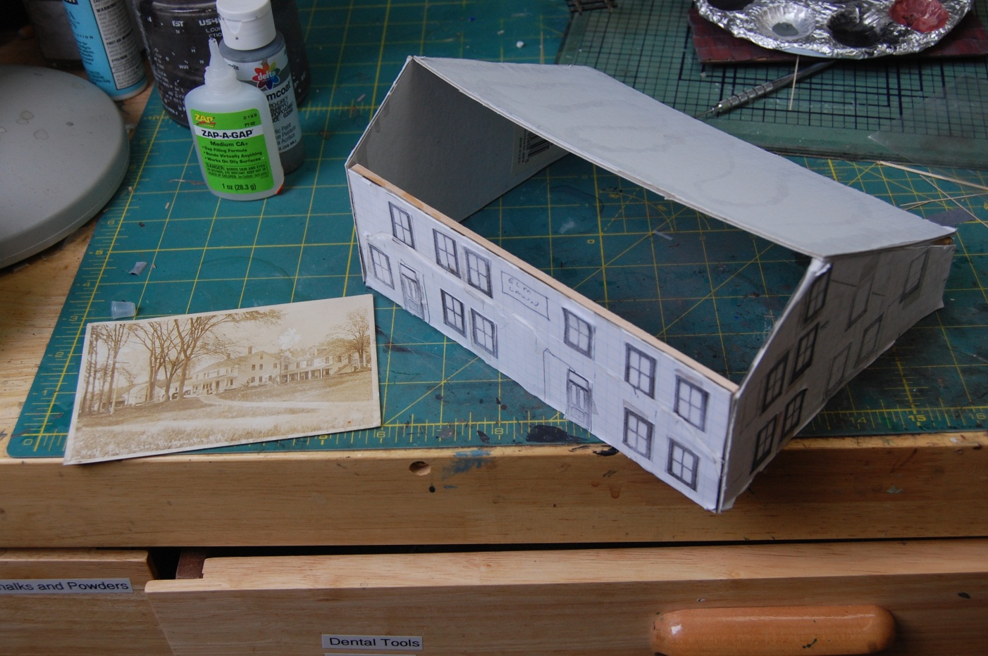
Making Mock Ups

Slide 20
Step Three
Materials

Slide 21
Wood
Kapler
Mt. Albert
Northeastern Scale Lumber
Midwest

Slide 22
Windows and Doors
Tichy
Grant Line
Northeastern Scale Lumber

Slide 23
Details
Tichy
BEST
Sierra West
Many others

Slide 24
Templates
Recycle from old kits
Draw on graph paper

Slide 25
Step Three
Construction

Slide 26
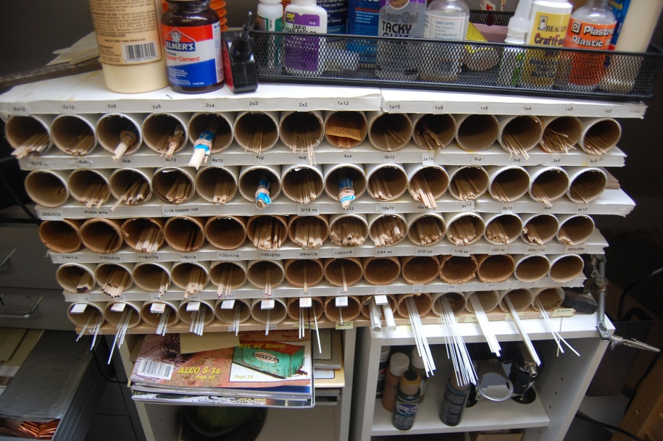
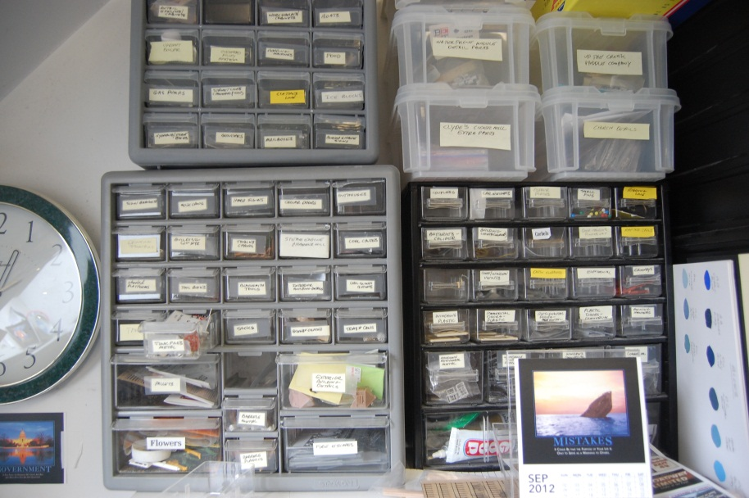
Work Environment
Wood
Details

Slide 27
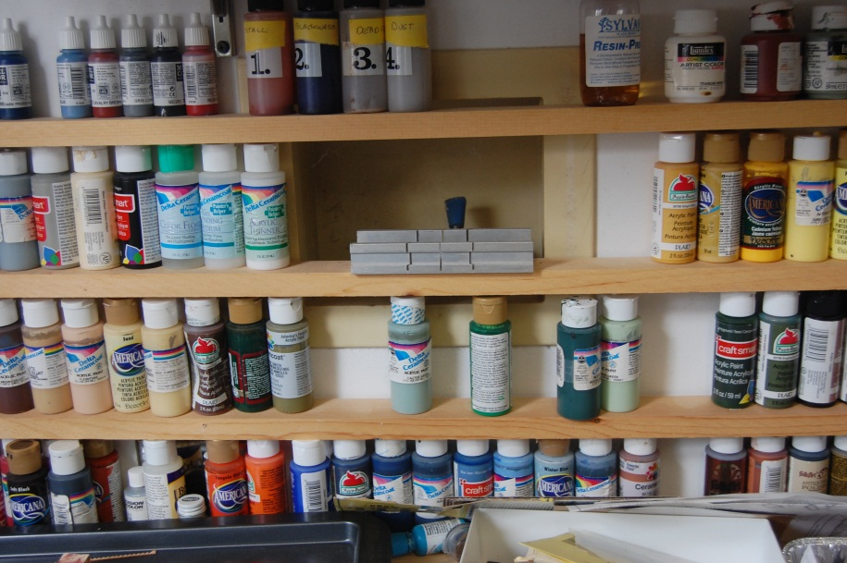
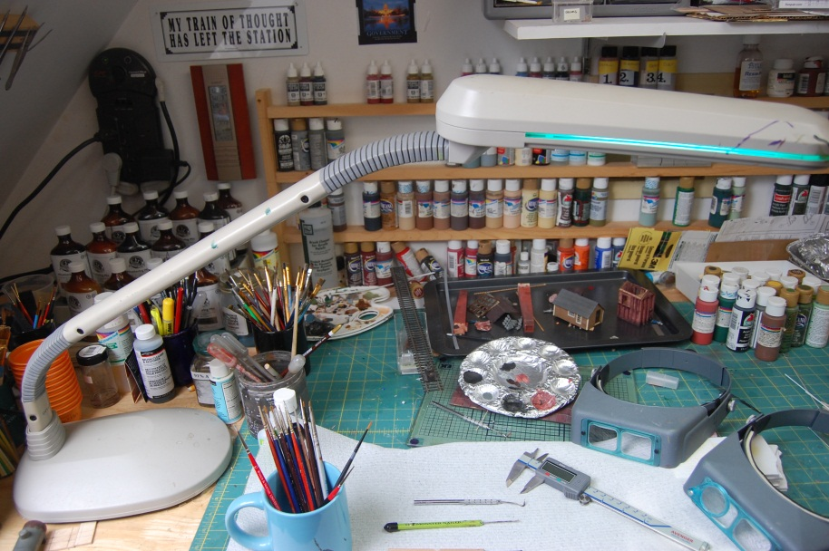
Work Environment 2
Paint
Ott Lamp

Slide 28
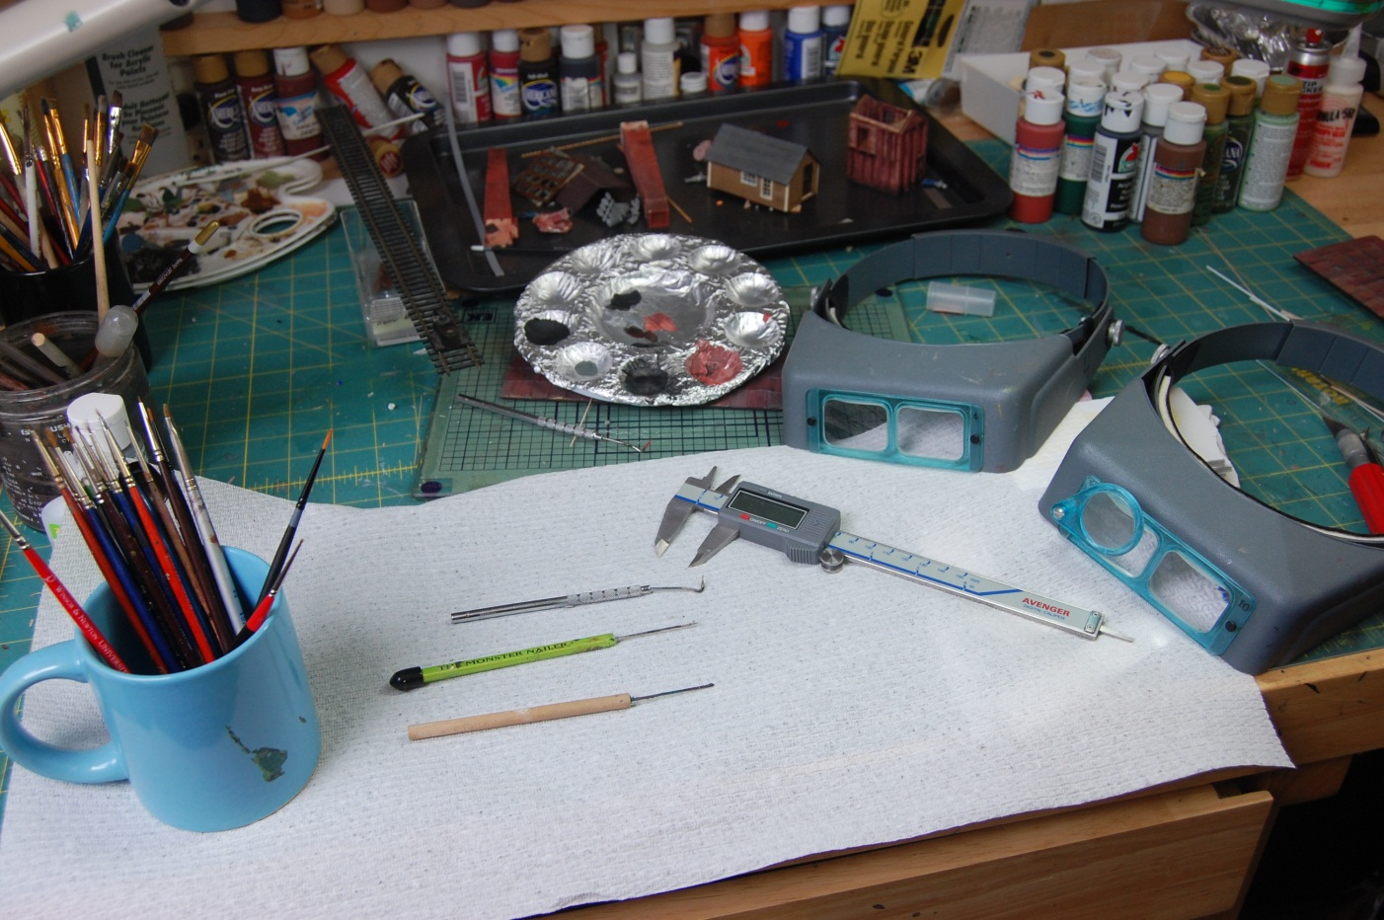
Tools

Slide 29
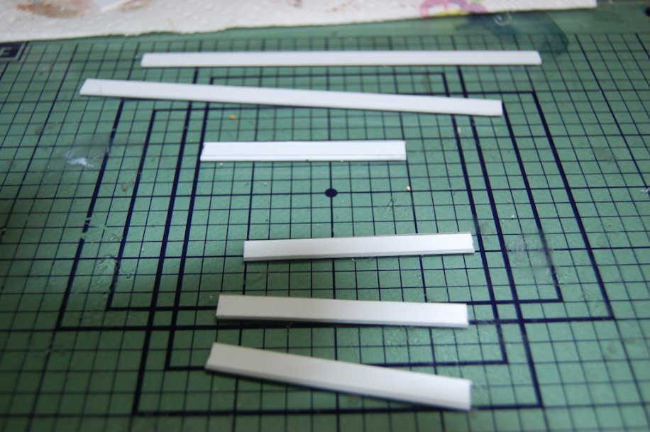
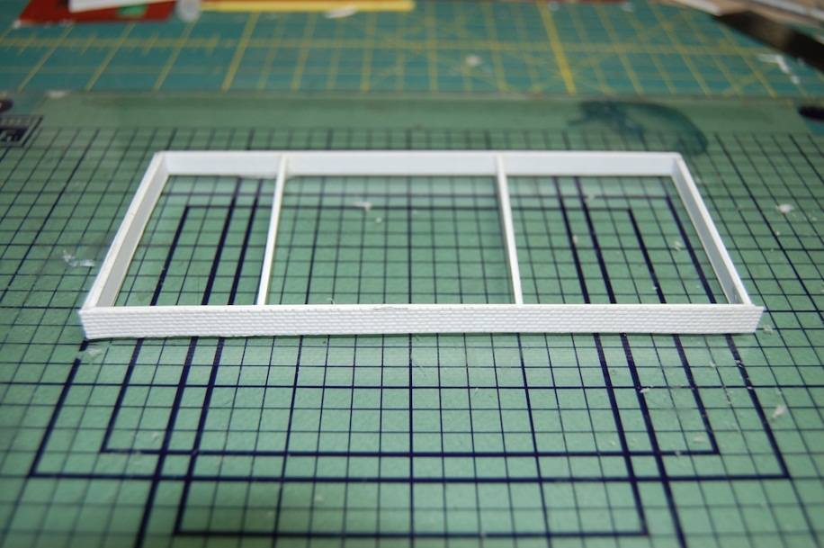
Framing the Foundation
Styrene strips
Assembled

Slide 30
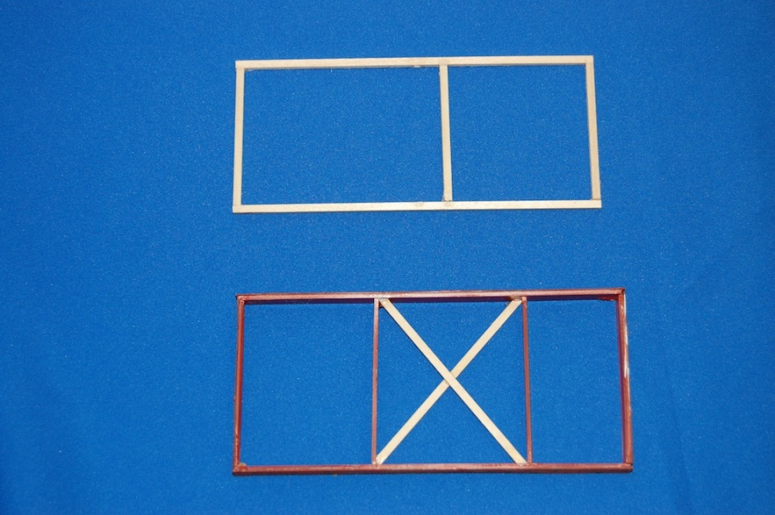
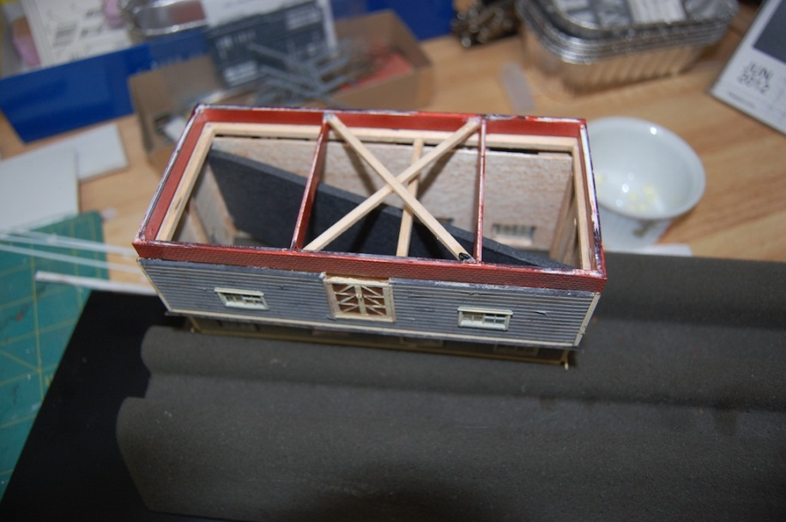
Foundation 2
Foundations
View from below

Slide 31
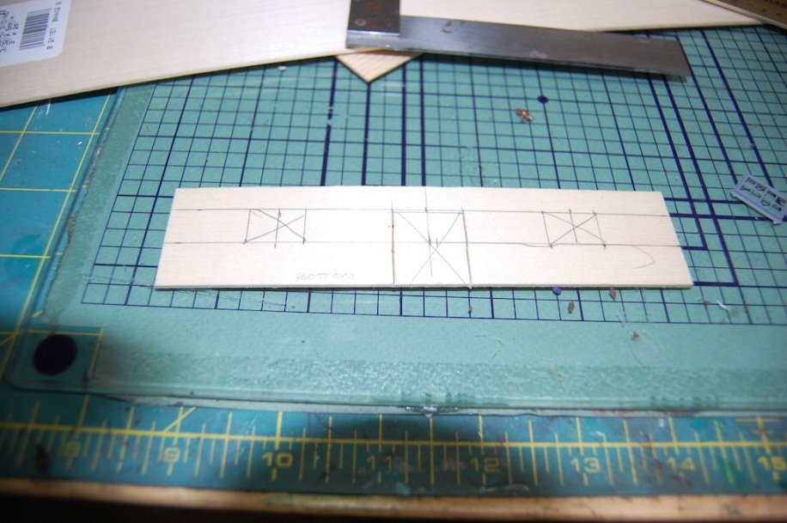
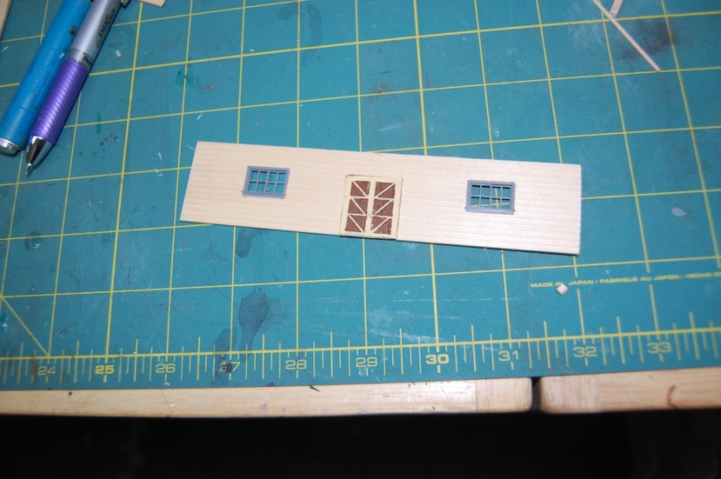
Walls 1
Locating openings
Test fit

Slide 32
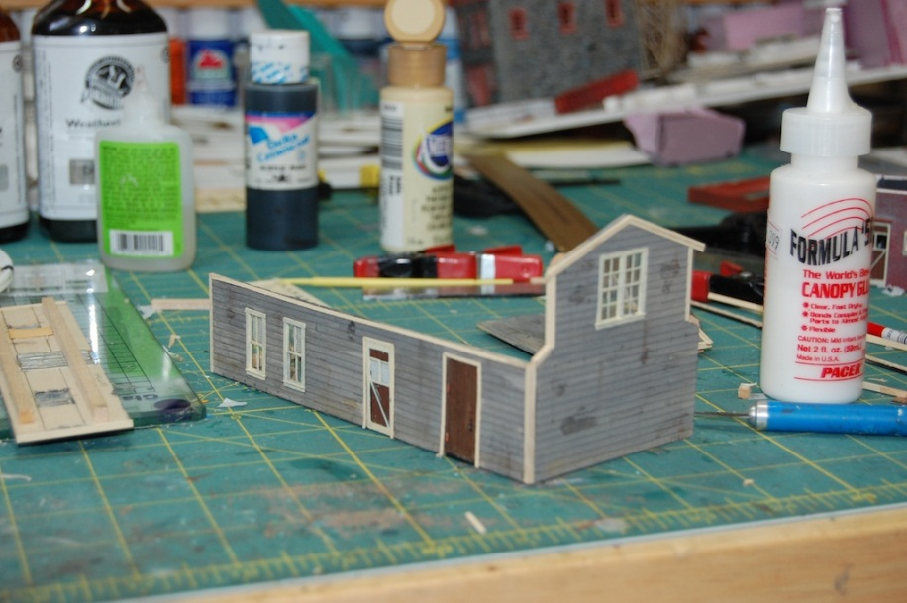
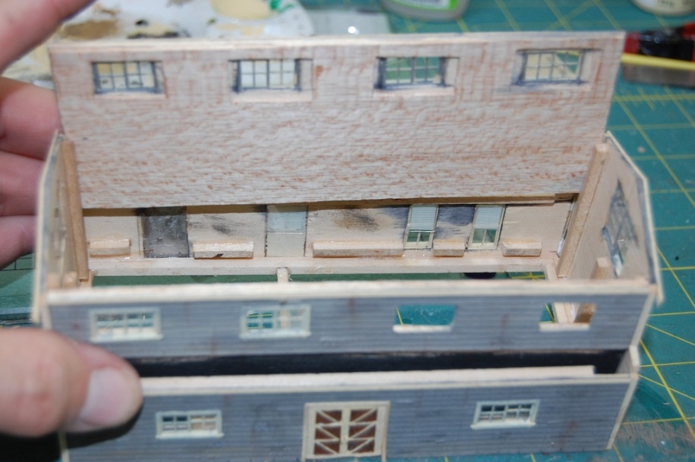
Walls 3
Half of exterior
Fitting upper section

Slide 33
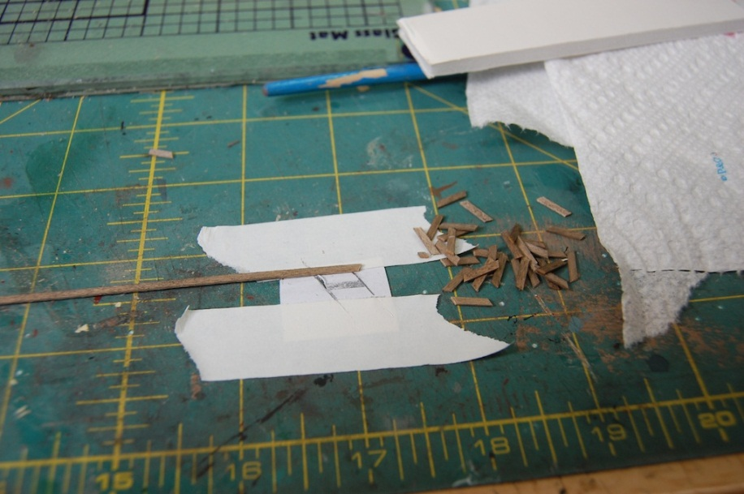
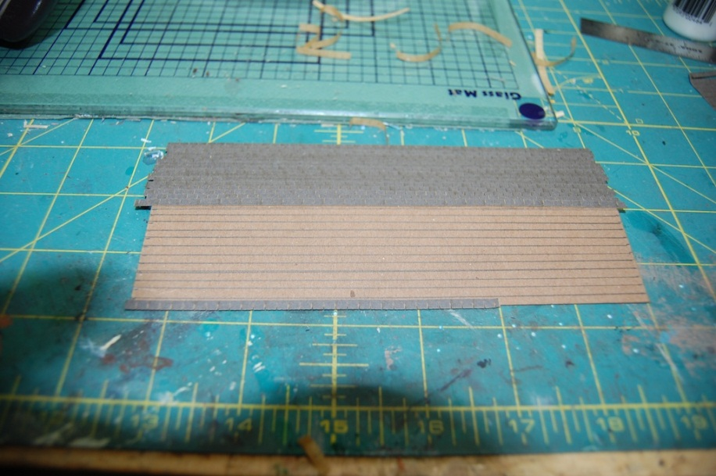
Roofs 1
Rafter tails
Aligning shingles

Slide 34
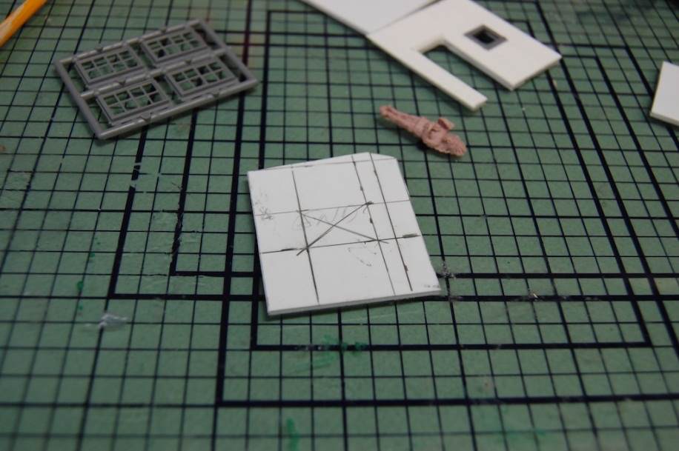
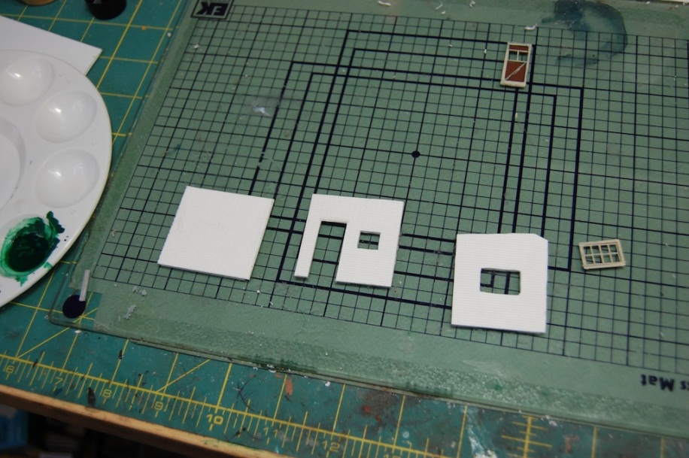
Boiler House
Placing openings
Walls cut out

Slide 35
Metal Roofing
Prime with gray auto primer
Light wash of diluted red craft paint
Streak with heavier colors of craft paint
Alcohol and ink wash
Oil paint streaks
Wash of various colors of chalk powder and alcohol
Dry coat of chalk powder

Slide 36
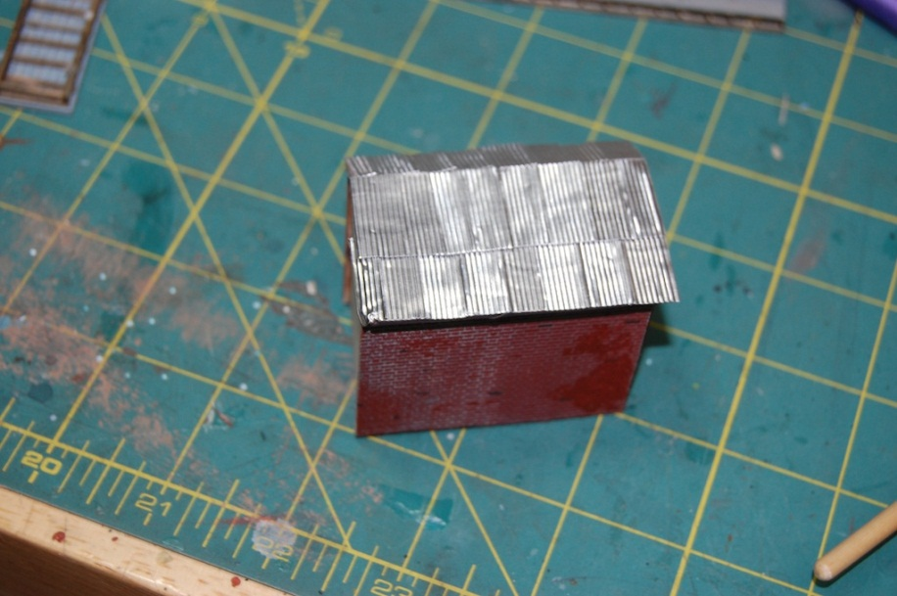
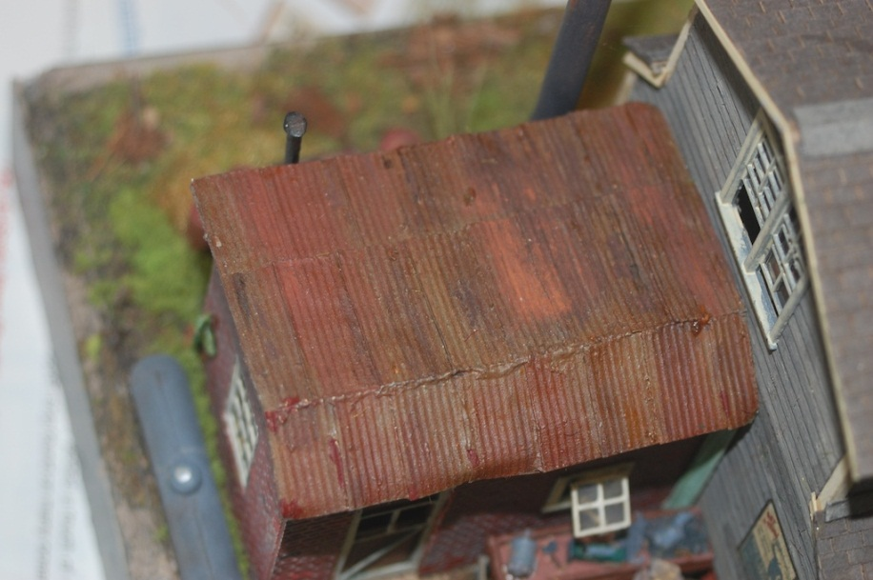
Boiler Roof
Start
Finish

Slide 37
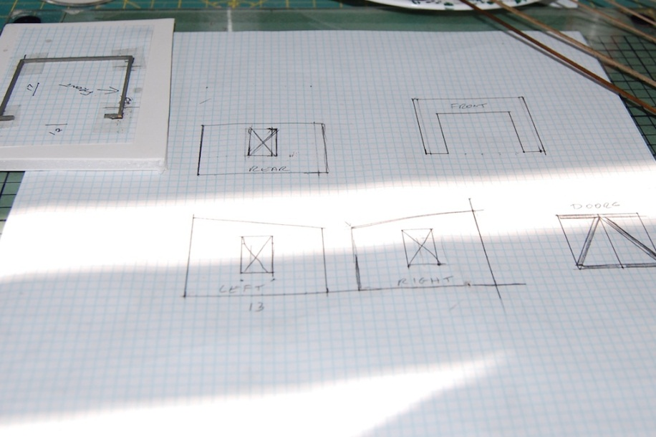
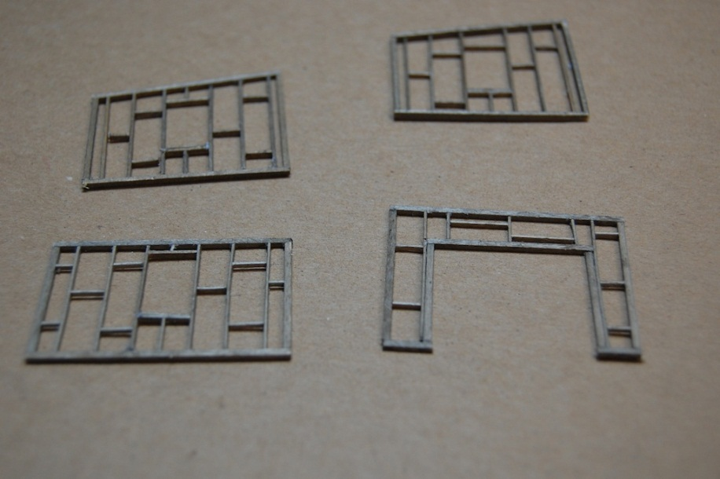
Building the Shed 1
Initial design on graph
Framework

Slide 38
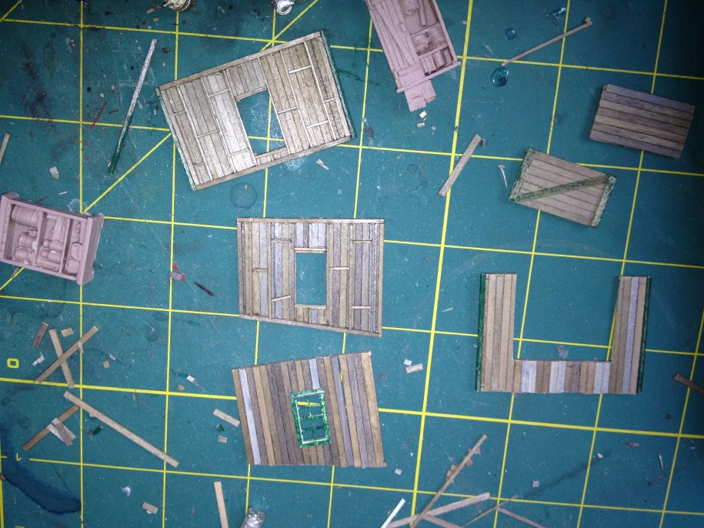
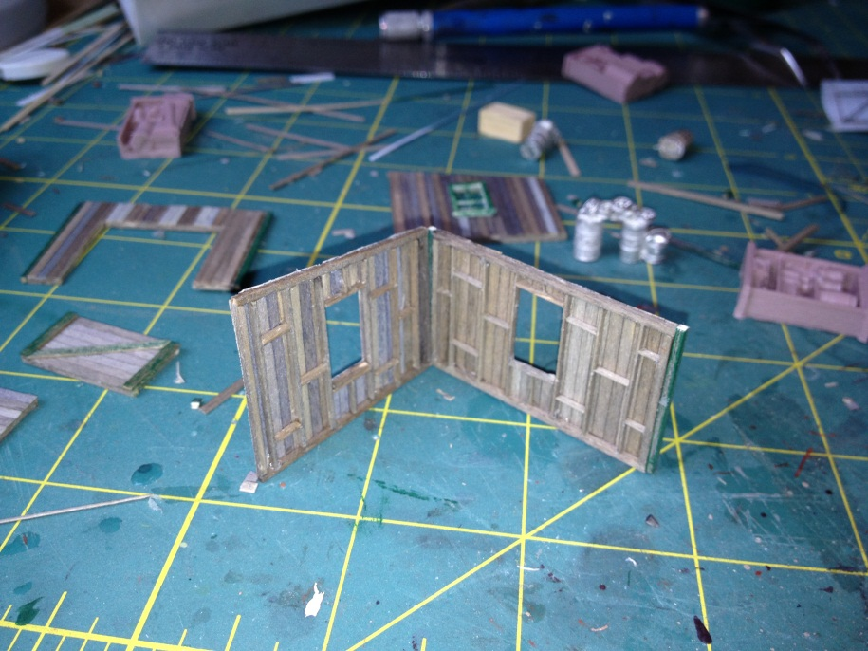
Building the Shed 2

Slide 39
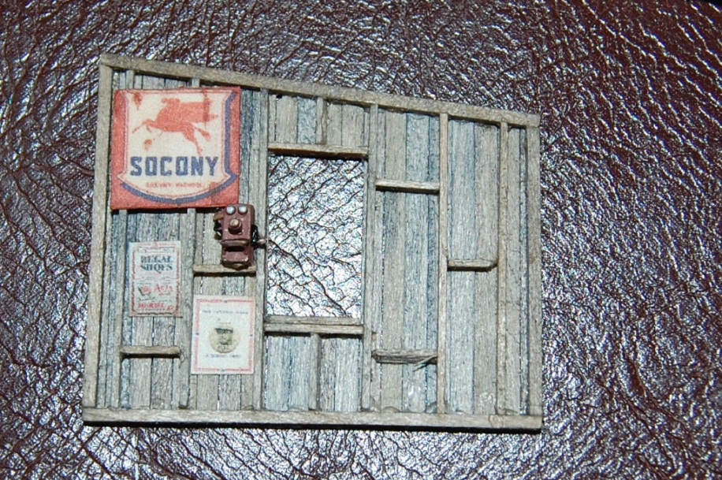
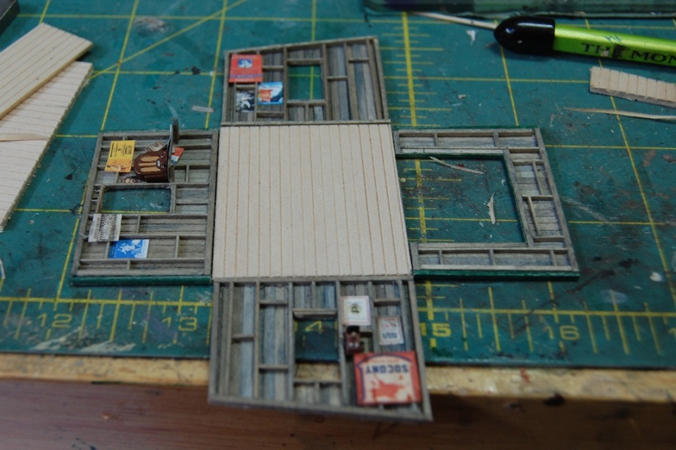
Building the Shed 3
Adding signs
The Duck Press

Slide 40
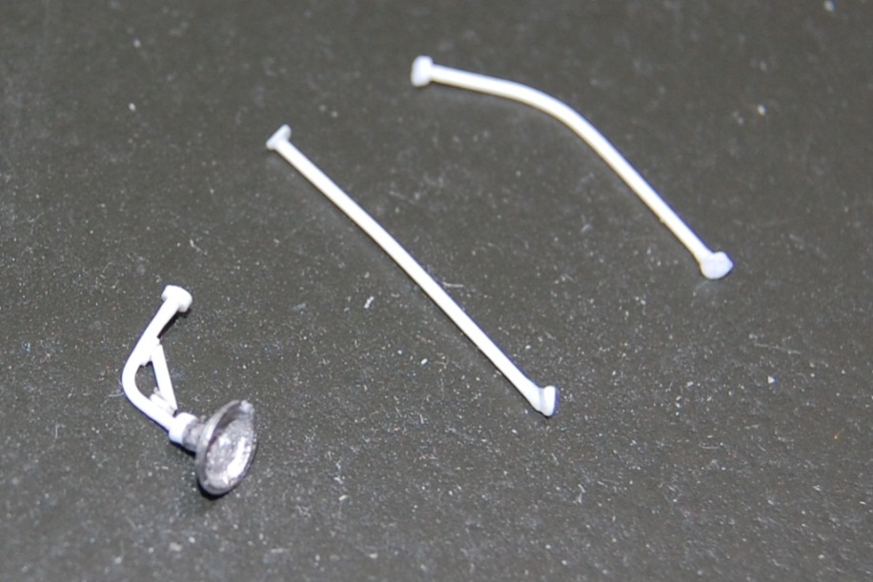
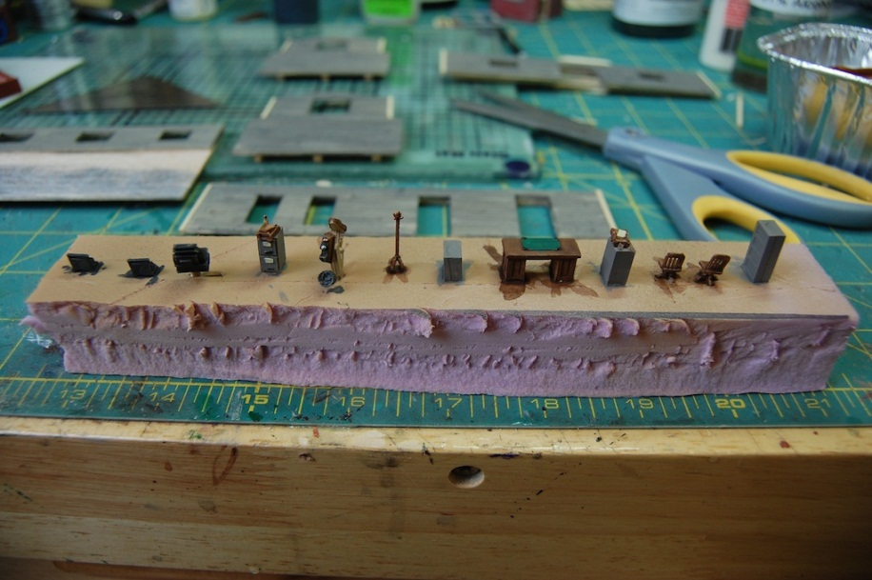
Lights and Rails
Styrene parts
Assembly Line

Slide 41
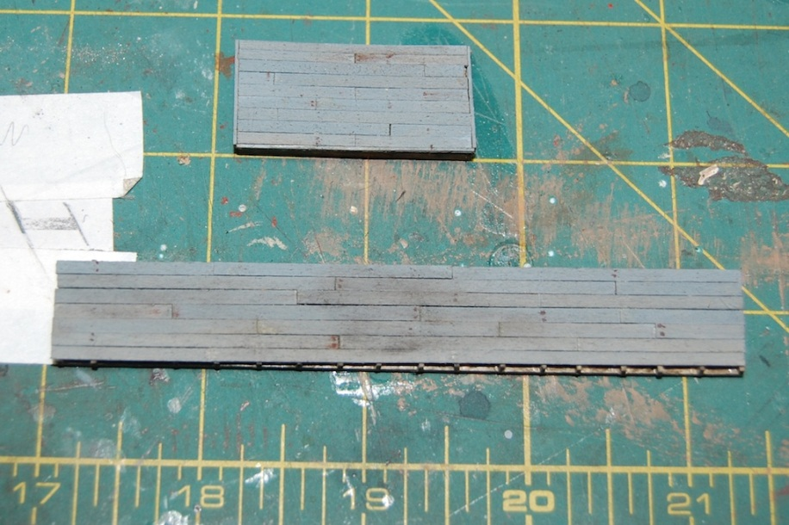
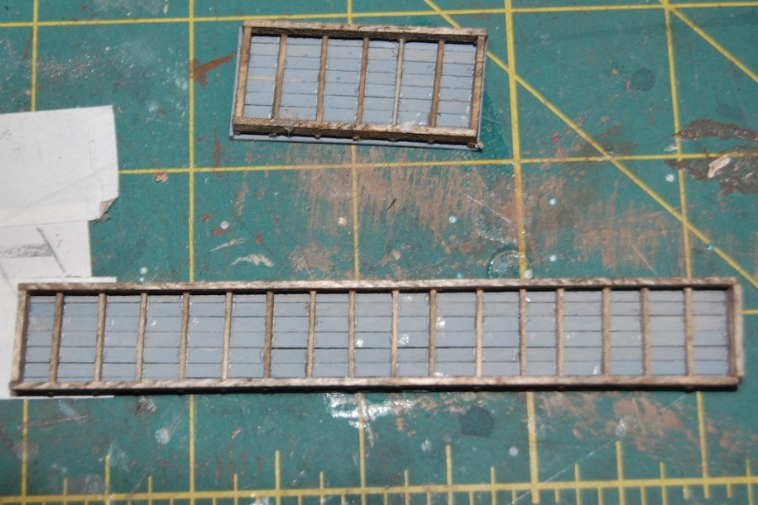
Loading Docks
Finished Top
Underneath

Slide 42
Signs

Slide 43
Where to Get Them
Commercial sources
Internet
Graphics Programs
Photographs

Slide 44

Internet search

Slide 45


Photographs

Slide 46


Slide 47
Thanks for Staying Awake!
Visit my site at:
SPERITRAINS.NET

